Slide 1

NIAID/INSIGHT/VA Collaboration:
ACTIV-3 Study Registration and Activation for VA Medical Center Sites and
Introduction of other INSIGHT COVID-19 Studies
Dial in (Main): (562) 247--8422
Dial in (Alt): (702) 489-0006
Attendee Access Code: 247-762-832
Slides in “Handout” Tab
VA Office of Research & Development/INSIGHT/DC ICC/VA CSP SCC
September 3, 2020

Slide 2
Acronyms
ACCT-1 | Adaptive COVID-19 Treatment Trial-1
ACTIV | Accelerating COVID-19 Therapeutic Interventions and Vaccines
CSP | Cooperative Studies Program
CSPCC | Cooperative Studies Program Coordinating Center
DC ICC | Washington DC International Coordinating Center
DCR | Division of Clinical Research at National Institute of Allergy and Infectious Diseases, NIH
DC VAMC | Washington DC VA Medical Center
FCOI | Financial Conflict of Interest
ICC | International Coordinating Center
ICR | Institute for Clinical Research, Inc. (Washington DC VAMC’s NPC)
INSIGHT | International Network for Strategic Initiatives in Global HIV Studies
NIAID | National Institute of Allergy and Infectious Diseases, NIH
NPC | Non-profit corporation
OWS | Operation Warp Speed
SCC | Site Coordinating Center
TICO | Therapeutics for Inpatients with COVID-19 (aka ACTIV-3)
VA CSP SCC | VA Cooperative Studies Center Site Coordinating Center at Perry Point—VA’s center for ACTIV and INSIGHT studies

Slide 3
PRESENTERS
Victoria Davey, PhD, MPH – Associate CRADO for Epidemiology and Public Health, VA network lead for ACTIV studies
Virginia Kan, MD – Leader, INSIGHT Washington DC International Coordinating Center (ICC), and Chief, Infectious Diseases Section, DC VA Medical Center (DC VAMC)
Cristin Harrington – Deputy Director, Perry Point Cooperative Studies Program Coordinating Center (CSPCC), and Coordinator, INSIGHT VA CSP Site Coordinating Center (VA CSP SCC)
Adriana Sánchez, MS – Executive Coordinator, INSIGHT Washington ICC, DC VAMC
Michael Vjecha, MD – Project Administrator, INSIGHT Washington ICC, DC VAMC

Slide 4
Introduction
VA has raised its hand to contribute to national and international studies on COVID-19 since the beginning of the pandemic
Accelerating COVID-19 Therapeutic Interventions and Vaccines (ACTIV) and Operation Warp Speed (OWS) are U.S. government initiatives to enable development of diagnostics, therapeutics, and vaccines
Getting OWS/ACTIV protocols launched at VA sites is the highest priority in ORD’s COVID-19 portfolio
Providing veterans with access to OWS/ACTIV clinical trials is a goal of our VHA Executive in Charge, Dr. Richard Stone
“..our clinical research capabilities and experience make us a premier environment for conducting these important studies” (Richard Stone, VHA USH Announcements, emailed 8/19/20)
VA ORD and Perry Point CSPCC are collaborating with the NIAID-funded INSIGHT network as part of the INSIGHT Washington DC International Coordinating Center (ICC) to conduct key INSIGHT COVID-19 studies
Notes:
OWS goal: to rapidly fund, coordinate, and offer regulatory support to enable the rapid development and distribution of novel diagnostics, therapeutics, and vaccines for COVID-19
Partners:
Department of Health & Human Services
Centers for Disease Control and Prevention (CDC)
Food and Drug Administration (FDA)
National Institutes of Health (NIH)
Biomedical Advanced Research and Development Authority (BARDA)
Department of Defense (DoD)
Department of Agriculture
Department of Energy
Department of Veterans Affairs
Pharma/Industry

Slide 5
OBJECTIVES
Provide key information about ACTIV-3 and other INSIGHT COVID studies available to VAMC sites in fall 2020
Describe ACTIV-3 / INSIGHT 014 / TICO: a major and complex Operation Warp Speed (OWS) initiative, under high pressure to enroll hospitalized COVID-19 participants to assess multiple candidate investigational neutralizing SARS-CoV-2-specific monoclonal antibodies, the most urgent initiative
Describe the INSIGHT network, DC ICC and VA CSP SCC/ORD collaboration, structure, governance, and communication processes
Describe the objectives, design, methods and endpoints of all INSIGHT COVID-19 studies, with a focus on INSIGHT 014 / ACTIV-3 / TICO
Describe the processes for registration and study activation for VAMC sites for any INSIGHT COVID-19 trial
Provide opportunity for questions and comments

Slide 6
OTHER INSIGHT COVID STUDIES FOR VA SITES
INSIGHT 011 / ICOS: An International Observational Study of Outpatients with SARS-CoV-2 Infection. Version 1 open at pilot sites. Version 2 approved by Advarra cIRB, opens late September 2020 at multiple US/international sites. N = 10,000 outpatients. Follow-up 28 days.
INSIGHT 012: An International Multicenter, Adaptive, Randomized Double-Blind Placebo-Controlled Trial of the Safety, Tolerability, and Efficacy of Anti-Coronavirus Hyperimmune Intravenous Immunoglobulin (hIVIG) for the Treatment of Adults Outpatients in Early Stages of COVID-19. Under development. Opens late 2020. N = 1,200 outpatients. Follow-up 28 days (90 days at a subset of sites). Exclusion criteria prevent co-enrollment with ACTIV-2.
INSIGHT 013 / ITAC: An International Multicenter, Adaptive, Randomized Double-Blind, Placebo-Controlled Trial of the Safety, Tolerability and Efficacy of Anti-Coronavirus Hyperimmune Intravenous Immunoglobulin (hIVIG) for the Treatment of Adult Hospitalized Patients at Onset of Clinical Progression of COVID-19. Version 1 under Advarra cIRB review. Opens late September 2020. N = 500 hospitalized participants. Follow-up 28 days (90 days at a subset of sites). ACTIV-3, CURES-1, HITCH also target inpatients; exclusion criteria may prevent co-enrollment.

Slide 7

OVERVIEW OF ACTIV-3—Dr. Virginia Kan

Slide 8
150+ sites across four INSIGHT ICCs
24+ VAMC sites
in VA CSP SCC
44 US sites
25 US sites

Slide 9

A Multicenter, Adaptive, Randomized, Blinded Controlled Trial of the Safety and Efficacy of Investigational Therapeutics for Hospitalized patients with COVID-19
ACTIV-3 / INSIGHT 014 / TICO
Short Title: Therapeutics for Inpatients with COVID-19 (TICO)
Funder and holder of US IND:
National Institute of Allergy and Infectious Diseases,
National Institutes of Health
and carried out by the
International Network for Strategic Initiatives in Global HIV Trials (INSIGHT)
in collaboration with other NIAID and NHLBI-supported trial networks
Version 1.0, 27th July 2020

Slide 10
ACTIV-3 Trial Design
A passive immunity trial of SARS-CoV-2 neutralizing monoclonal antibodies.
Feature | Stage 1 | Stage 2
Target population | COVID-19 inpatients, symptoms ≤ 12 days No organ failure | COVID-19 inpatients, symptoms ≤ 12 days Organ failure allowed
Endpoint | Pulmonary/Pulmonary+ scales (ACTT-1 ordinal scale plus non-pulmonary complications) at day 5 | “Time to sustained recovery” through 90 days (improved ACTT-1 time-to-recovery endpoint)
Sample size (per arm) | 150 (i.e., 300 for a single agent, 450 for two agents) | 500 (i.e. 1000/1 agent & 1500/2 agents) including pts from Stage 1
Power | 95% power to detect OR 1.60 for benefit; 1-sided 𝛼 of 0.30 | 90% power to detect 25% increase in recovery rate; 1-sided 𝛼 of 0.025
Standard of Care | Supportive care; remdesivir (trial-supplied); steroids (optional and per local supply)

Slide 11
OVERVIEW OF ACTIV-3
Inclusion criteria:
Age ≥ 18 years.
Informed consent by the patient or the patient’s legally-authorized representative
SARS-CoV-2 infection, documented by PCR within 3 days prior to randomization OR documented by PCR more than 3 days prior to randomization AND progressive disease suggestive of ongoing SARS-CoV-2 infection per the responsible investigator
Duration of symptoms attributable to COVID-19 ≤ 12 days per the responsible investigator.
Requiring admission for inpatient acute medical care for clinical manifestations of COVID-19, per the responsible investigator, and NOT for purely public health or quarantine purposes
Women of child-bearing potential who are not already pregnant at study entry must be willing to abstain from sexual intercourse with men or use at least one form of hormonal or barrier contraception (which must include use of a spermicide) through study day 90
Men must be willing to abstain from sexual intercourse with women of child-bearing potential or to use at least one form of hormonal or barrier contraception (which must include use of a spermicide) through study day 90
Exclusion criterion:
1. Prior receipt of convalescent plasma, hyperimmune globulin (hIVIG), or neutralizing monoclonal antibodies for SARS-CoV-2

Slide 12
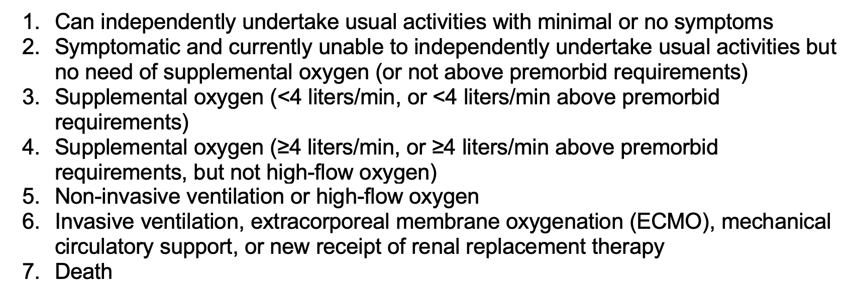
OVERVIEW OF ACTIV-3
Stage 1 Pulmonary Endpoint (same as in ACTT-1)

Slide 13
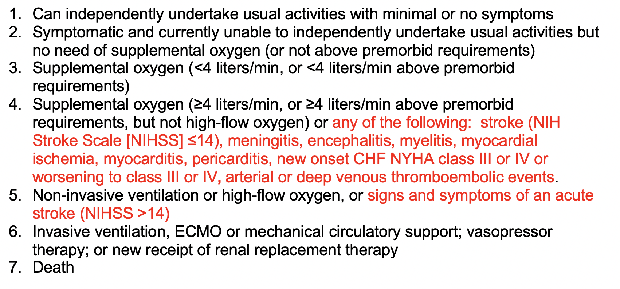
OVERVIEW OF ACTIV-3
Stage 1 Pulmonary+ Endpoint (expanded)

Slide 14
OVERVIEW OF ACTIV-3
Stage 2 Primary Endpoint
Time from randomization to sustained recovery, defined as being discharged from the hospital, followed by being alive and home for 14 consecutive days prior to Day 90
Home defined as the level of residence or facility where the patient was residing prior to hospital admission leading to enrollment in this protocol
Death prior to sustained recovery will be analyzed as not having achieved sustained recovery to Day 90
Once sustained recovery is achieved, reclassification of the primary endpoint will not occur (subsequent rehospitalization, change in level of care, or death will be captured in secondary endpoints)

Slide 15
OVERVIEW OF ACTIV-3
First agent: LY3819253
Trial Oversight Committee: excellent SARS-CoV-2 potency profile among the receptor binding domain antibodies available
Developed by Lilly Research Laboratories and AbCellera Biologics Inc.
  Phase I completed and phase IIa (BLAZE-1 is ongoing and blinded for 7 g dose)
  To be studied in both ACTIV-2 (outpatients) and ACTIV-3 (inpatients)
Ig G1 monoclonal antibody
Derived from B lymphocytes of a naturally convalescent COVID-19 patient = fully human
Binds to Receptor Binding Domain of Spike protein
Given as a 7 g single infusion based on t_{1/2} of 19 days
Convalescent serology to determine whether the nMAb interferes with host active immunity
Antibody-dependent exacerbation (“ADE”) a theoretical concern which will be monitored via stage 1 and 2 endpoints and safety outcomes

Slide 16
OVERVIEW OF ACTIV-3
Does the convalescent plasma emergency use authorization (EUA) alter the need for passive immunity trials?
"The EUA is not intended to replace randomized clinical trials and facilitating the enrollment of patients into any of the ongoing randomized clinical trials is critically important for the definitive demonstration of safety and efficacy of COVID-19 convalescent plasma. The FDA continues to recommend that the designs of ongoing randomized clinical trials of COVID-19 convalescent plasma and other therapeutic agents remain unaltered, as COVID-19 convalescent plasma does not yet represent a new standard of care based on the current available evidence."

Slide 17
OVERVIEW OF ACTIV-3
Enrollment Status
First participant enrolled on August 5
Today: 68 enrolled all at US sites
24+ potential VAMC sites (initially)
Up to 300+ sites in all networks (worldwide)
Study completed in 2 years dependent on COVID activity

Slide 18
ACTIV-3: REQUIREMENTS FOR REGISTRATION/ACTIVATION—
Cristin Harrington

Slide 19
ACTIV-3: REQUIREMENTS FOR REGISTRATION/ACTIVATION
Site Selection
Interest
Experience
Ability to start rapidly
Local COVID-19 epidemiology
Site registration/activation processes will allow ACTIV-3 to dynamically study investigational agents in fluctuating transmission ”hot spots” while carefully managing drug supply

Slide 20
ACTIV-3: STEPS TO REGISTRATION/ACTIVATION
Communicate interest to ORD: ORDCOVID19@va.gov
  a. may require completed ACTIV Survey
Develop Registration Plan w/VA CSP SCC (instructions, templates, timelines)
Attend routine Investigator calls— Weds at 10 am EDT
Use HUDDLE to post required forms & protocol approvals
Complete required Protocol Training
Get approval of Pharmacy Plan & complete virtual visit
Receive study supplies
Get site registration completion and activation approval from INSIGHT

Slide 21








ACTIV-3: SITE REGISTRATION/ACTIVATION PROCESS

Slide 22
ACTIV-3: SITE REGISTRATION/ACTIVATION PROCESS
Personnel
Key Personnel – Identify ASAP
Principal Investigator / Site Leader
Site Coordinator
Pharmacist*
Supporting Personnel
Sub-Investigator(s)
Back-up Pharmacists
Research Assistants/Technicians
Regulatory Support

Slide 23


ACTIV-3: SITE REGISTRATION/ACTIVATION PROCESS
Required Documentation, Staff
Training
Human Subjects Protection (HSP)
Good Clinical Practices (GCP)
Protocol Training
Weekly Investigators’ Meetings
Qualifications
CVs
Medical Licenses
Agreements & Disclosures
FDA Form 1572
FCOI

Slide 24
ACTIV-3: SITE REGISTRATION/ACTIVATION PROCESS
Required Documentation, Site
Logs
Training Log
Randomizer Log
Delegation Log
Labs
Norms
Certifications
Pharmacy*
Pharmacy Plan
Virtual Visit

Slide 25
ACTIV-3: SITE REGISTRATION/ACTIVATION PROCESS ASSISTANCE
PLATFORMS
INSIGHT Website
Site Level Credentials
HUDDLE
Regulatory file sharing platform
Expedites receipt/review of required docs
Essential Documents
Protocol & ICFs
Investigators Brochures
Procedural Manuals
CRFs
Regulatory Templates
REDCap
Access via INSIGHT Web
Electronic data capture
Queries & Reports
Randomization
Trainings
FAQs
Directory

Slide 26
REDCap— DATA ENTRY
INSIGHT WEBSITE-- RANDOMIZATION
Access to these platforms will be provided by INSIGHT.
REDCap will be used for electronic data entry
REDCap is maintained and managed by INSIGHT at the University of Minnesota
Required REDCap training is available on INSIGHT website
Randomization Application through INSIGHT website
Practice randomizations by designated staff are required for site activation
Must be done prior to “live” randomization and data entry

Slide 27
ACTIV-3: PRIVACY & INFORMATION SECURITY
Required Reviews/Approvals of Platforms
VA OI&T Centralized Privacy & Information Security Review
VAMCs provide essential information to VA CSP SCC
VA CSP SCC collects & submits to VA OI&T for review
VA OI&T executes central review, issues report for VAMCs
Local ISO/PO approval to ensure safe storage of data submitted to REDCap

Slide 28
ACTIV-3: REQUIRED REVIEWS
Advarra is the Commercial single IRB (sIRB)
**No local IRB review needed**
Requires site reliance agreement with Advarra; wise to develop local SOPs
Advarra must be included on site’s FWA
Help is available from the ORD Office of Research Policy, Protections & Education
Template ICFs provided
Average approval time ≈ 3 days
Local R&DC Review
Ensure R&DCs’ SOPs allow for ad hoc reviews
Prepare your R&DC for the fast-paced registration requirements for this prioritized critical trial
Identify rate-limiting factors and discuss these with VA CSP SCC

Slide 29

LESSONS LEARNED & TIPS FOR WARP SPEED
Create a Project Plan
Communicate
Designate Personnel
ID the Order of Operations
Anticipate Hurdles
Sound the Alarm—ASK FOR HELP
“Measure Twice, Cut Once”
Attend Calls & Meetings
Embrace Efficiencies
Think Outside the Box
Delegate a POC
Be Flexible

Slide 30
PHARMACY REQUIREMENTS—Adriana Sánchez

Slide 31
PHARMACY REQUIREMENTS
An INSIGHT Study Pharmacist is anyone who is involved in obtaining treatment assignments, receipt, handling or storage of study drug, or the preparation or dispensing of study treatment to sites. These individuals are unblinded and must not be involved in the care, assessment or data collection of study participants.
INSIGHT investigational study products must be secured, segregated, and stored per manufacturer requirements.
All areas and units storing study products must have a system in place for electronic temperature monitoring, with temperature recorded at least every 60 minutes.
All pharmacies must comply with the INSIGHT COVID-19 study Pharmacy Plan.

Slide 32
PHARMACY REQUIREMENTS
INSIGHT COVID-19 study pharmacies must maintain study-specific SOPs and drug accountability logs.
Study Site Pharmacies (with unblinded pharmacists) must have specific SOPs for delivery of investigational products to Local Site Pharmacies –presently all VAs site have Study Site Pharmacies with no plans for sharing with other Local Site Pharmacies
The INSIGHT Washington ICC is required to conduct a virtual online visit to each INSIGHT COVID-19 Study Site Pharmacy and the DC ICC must certify that the pharmacy meets protocol requirements prior to study activation.
The first INSIGHT 014 / ACTIV-3 / TICO investigational agent: LY3819253, requires refrigeration at 2-8°C prior to infusion.

Slide 33
PHARMACY REQUIREMENTS
US sites will also receive a formulation of liquid remdesivir from Gilead Pharmaceuticals, which requires refrigeration at 2 - 8°C. This is provided as Standard of Care to study participants in both arms, and as such, is a study product, though not an investigational agent. Lyophilized remdesivir, which may be available in the future to US sites, is stored at ambient temperature.
Prior to site activation, Study Site Pharmacies will receive a supply of sleeves and labels for IV infusion bags for study product and placebo to maintain the blind.
Prior to study activation, study products will be shipped to the site by PCI Services.
Other investigational products will be shipped when they become available.

Slide 34
CONTRACTS, TASK ORDERS, BUDGETS—Dr. Michael Vjecha

Slide 35
CONTRACTS, TASK ORDERS, BUDGETS
For all INSIGHT COVID-19 trials, NIAID/NIH is the source of funds, through contracts between Leidos Biomedical Research, Inc., and the University of Minnesota. INSIGHT passes funds to the Institute for Clinical Research, Inc., (ICR), the non-profit-corporation (NPC) at the DC VAMC, to support all INSIGHT DC ICC site institutions.
ICR executes a Master Contract (with general NIH terms and conditions, Site Leader designation, and overall performance period) and a study-specific Task Order (with Scope of Work, Budget Ceilings, Cost Schedule and Payment Schedule). For VAMC sites, these agreements are executed with each affiliated non-profit-corporation (NPC).
All INSIGHT study Task Orders are structured as “fee-for-service/fixed-unit-price” agreements, with payments based on work completed (e.g., number participants enrolled, CRFs uploaded, specimens received, etc.) These are not “cost reimbursement” agreements, so sites are not required to submit invoices or expenditure reports.

Slide 36
CONTRACTS, TASK ORDERS, BUDGETS
Once ICR receives quarterly documentation and payment from the University of Minnesota, the DC ICC will issue remittance emails to sites and ICR will send checks to each site’s institution, usually 6-8 weeks after the end of each quarter (Jan-Mar, Apr-Jun, Jul-Sep, Oct-Dec), depending on the receipt of funds from INSIGHT.
Site Leaders are free to allocate INSIGHT payments to support research, including hiring of research staff and purchase of equipment, supplies, and other needs, like PPE, without time limits, though in accordance with research allocation guidelines outlined in the NIH Grants Policy Statement.
NIH provides Facilities & Administrative Costs (F&A, or indirect costs/IDC) on the base of Administrative Costs for each INSIGHT COVID trial, but not on the total of Participant Costs. The base of Administrative Costs in INSIGHT 014 / ACTIV-3 / TICO is unique among previous NIAID-funded INSIGHT trials.
The amount of potential site payments for Administrative and Participant Care Costs differs between the four INSIGHT COVID-19 trials.

Slide 37
CONTRACTS, TASK ORDERS, BUDGETS
The following is the Cost Schedule for INSIGHT 014 / ACTIV-3 / TICO for Washington ICC sites, including sites within the VA CSP SCC:
INSIGHT 014 / ACTIV-3 TICO Administrative Cost Schedule
TICO v1.0
Registration/Study Site Pharmacy @ $10,000.00 paid upon protocol registration + site F&A
Start-up/Study Site Pharmacy @ $17,500.00 paid upon site activation + site F&A
Accrual (per participant) @ $1,000.00 paid upon completed eCRF + site F&A
INSIGHT 014 / ACTIV-3 TICO Participant Care Cost Schedule No F&A
TICO v1.0
Enrollment/Baseline Visit + Specimen @ $7,500.00 per completed eCRFs + specimen rec'd at repository
Day 5 Visit + Specimen @ $7,500.00 per completed eCRFs + specimen rec'd at repository
Day 28 Visit + Specimen @ $5,000.00 per completed eCRFs + specimen rec'd at repository
Day 90 Visit + Specimen @ $5,000.00 per completed eCRFs + specimen rec'd at repository
Genomics 004 v2.0
Genomics specimen @ $150.00 per specimen rec'd at repository
Sites will soon receive two one-page forms to provide key contact and contract/payment information. ICR will then generate site-specific documents for sites to review prior to final execution. For sites open and accruing before 30 September, INSIGHT payment will be made by ICR in mid-November.

Slide 38
HELP AND RESOURCES & SUMMARY —Dr. Vicky Davey

Slide 39
HELP AND RESOURCES
Any questions may go to VA CSP SCC (activreg@va.gov )
In addition:
  Medical management questions, investigational drug/study drug use questions, SAE questions and reports may go to our DC ICC Medical Monitor, Dr. Amy Weintrob (amy.weintrob@va.gov)
  Site funding questions to Dr. Mike Vjecha at DC ICC (michael.vjecha1@va.gov )
  Pharmacy questions to Adriana Sánchez at DC ICC (adriana.sanchez@va.gov )
ORD questions—on other ACTIV/OWS studies, policy, local barriers to COVID-19 research—email ORDCOVID19@va.gov or Vicky Davey (victoria.davey@va.gov)

Slide 40
SUMMARY
Why ACTIV-3?
Promise: perhaps, treatments for COVID-19
Contribution: to the global effort
Access: for Veterans
Efficiency: multiple investigational agents will be tested
Opportunity: for VA researchers—publications, access to data and biospecimens
Capability: VA has experience in multicenter clinical trials
Challenge: of a master, adaptive, platform protocol

Slide 41

THANK YOU AND QUESTIONS
For additional information:
Email ORD
ORDCOVID19@va.gov
Website for OWS https://www.hhs.gov/about/news/2020/06/16/fact-sheet-explaining-operation-warp-speed.html
Website for ACTIV https://www.nih.gov/research-training/medical-research-initiatives/activ
Website for INSIGHT
http://insight-trials.org/

Slide 42
AVAILABILITY OF RECORDING
A recording of this session and the associated handouts will be available on ORPP&E’s Education and Training website approximately one-week post-webinar
An archive of this and other webinars can be found here: https://www.research.va.gov/programs/orppe/education/webinars/archives.cfm

